Slide 1
Grammar of Graphics
Week 3, Computational Genomics
Notes:
Ideas adopted from Hadley Wickham’s https://r4ds.had.co.nz/data-visualisation.html

Slide 2
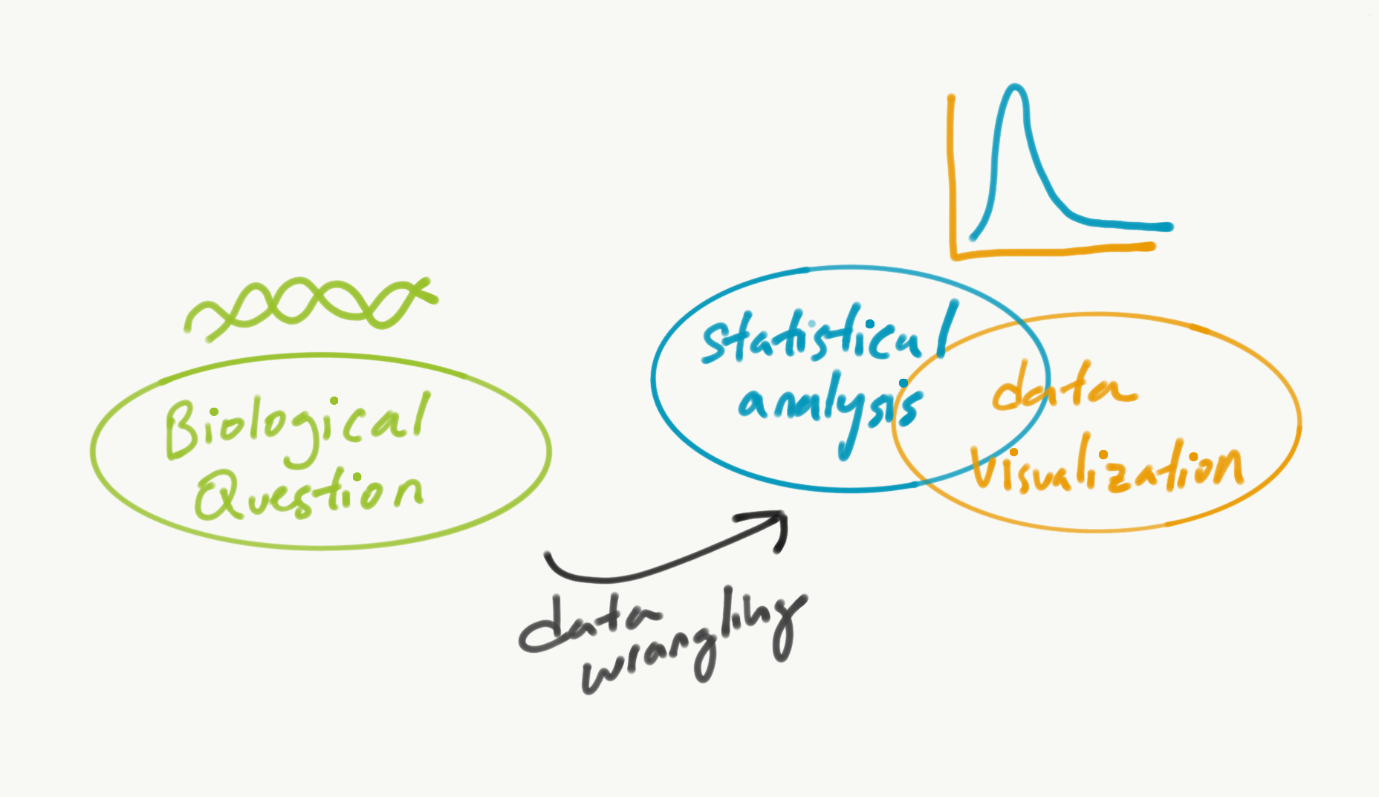
Data visualization
Notes:
Ask: what is the purpose of visualization?
- to summarize the complexity of data effectively (what is the overall landscape of the data? The distribution?)
- show a trend that you want to communicate. (perhaps you can do it just in words!)

Slide 3
Common plots
Univariate
Bivariate
Data Type | Plot
Numeric (e.g. heights)
String (e.g. names)
Logical (e.g. on time or not)
Data Type | Plot
Numeric, Numeric (e.g. height and weight)
Numeric, String (e.g. name and age)
Numeric, Logical (e.g. on time/not and max speed of car)
Logical, Logical (e.g. fast vs slow growth, large vs small)
Notes:
Def: Univariate, bivariate, multivariate
Google Doc worksheet

Slide 4
Common plots
Univariate
Bivariate
Data Type | Plot
Numeric (e.g. heights) | Histogram
String (e.g. names) | Bar plot
Logical (e.g. on time or not) | Table
Data Type | Plot
Numeric, Numeric (e.g. height and weight) | Scatterplot
Numeric, String (e.g. name and age) | Box plot
Numeric, Logical (e.g. on time/not and max speed of car) | Box plot
Logical, Logical (e.g. fast vs slow growth, large vs small) | Table

Slide 5
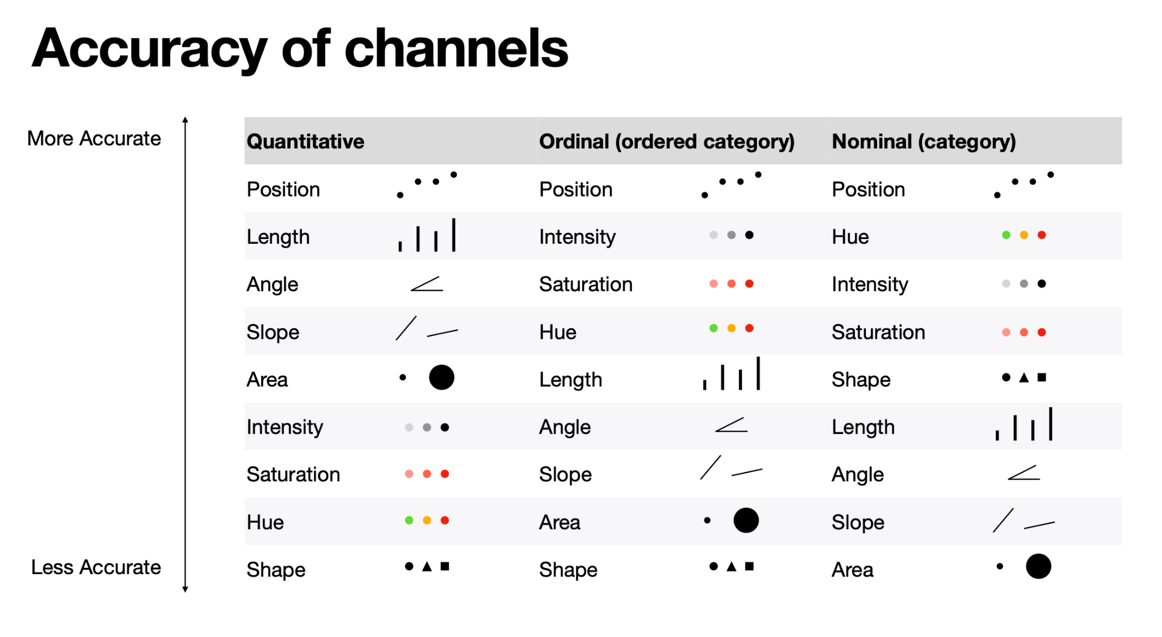

Slide 6
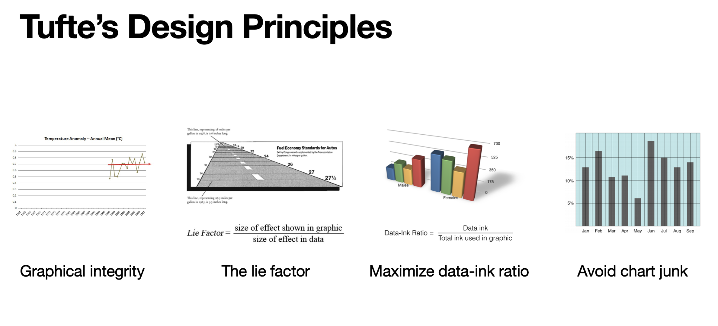
Does it show the whole dataset?
Does it tell a story you want to convey?

Slide 7
I just realized…..
We have no idea how tall each other are! (except for Chris & Cooper)

Slide 8
What would be a good way to represent the distribution of heights in the group?

Slide 9
Grammar of graphics (ggplot)
Data
Geometry, containing a mapping to the data
Additional settings
ggplot(iris) + geom_histogram(aes(x = Sepal.Width))
Notes:
Geometry is a particular plot (graphical display) that depends on the data - usually one of the 7 plots.
One can add more than one geometries - scatterplot + histogram?
The mapping argument maps the data to the geometry: in particular, the x and y coordinates for scatterplot/geom_point.
The variables referred to x and y are data variables (columns from the data).

Slide 10
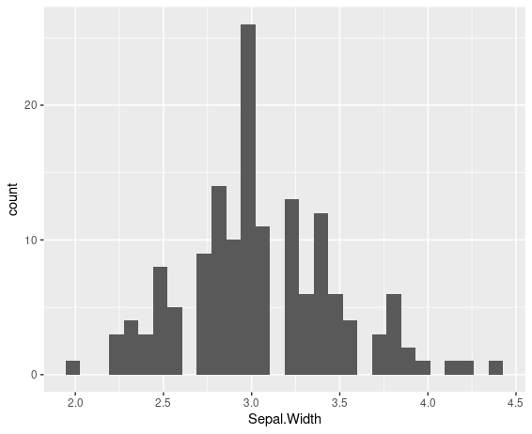
Histogram
ggplot(iris) + geom_histogram(aes(x = Sepal.Width))
Notes:
Does this show the whole data? What is the trend it is emphasizing?
Also known as a distribution - collection of measurement for many samples.
Maximizes position and length.

Slide 11
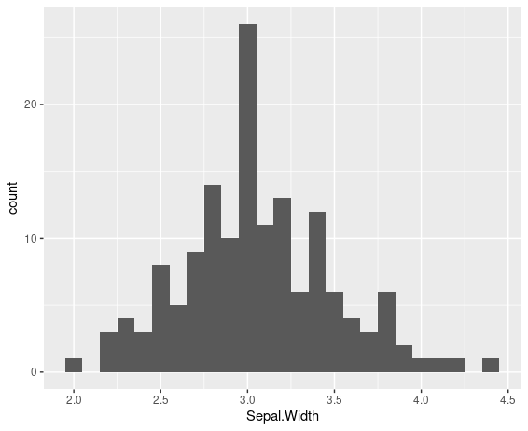
Histogram
ggplot(iris) + geom_histogram(aes(x = Sepal.Width), binwidth = .1)
Notes:
Additional arguments in geom_histogram. Note it’s outside of mapping argument, as it doesn’t depend on the dataset.

Slide 12
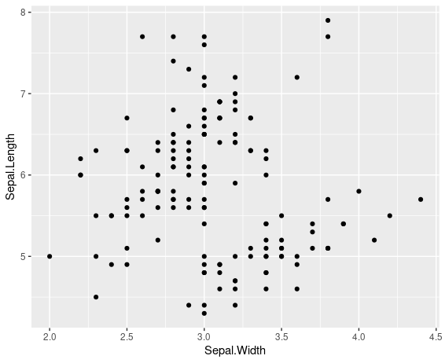
Scatterplot
ggplot(iris) + geom_point(aes(x = Sepal.Width, y = Sepal.Length))
Notes:
Does this show the whole data? What is the trend it is emphasizing?
Review: What does the dataframe look like, if one doesn’t know anything about the iris dataframe?
Maximizes position

Slide 13
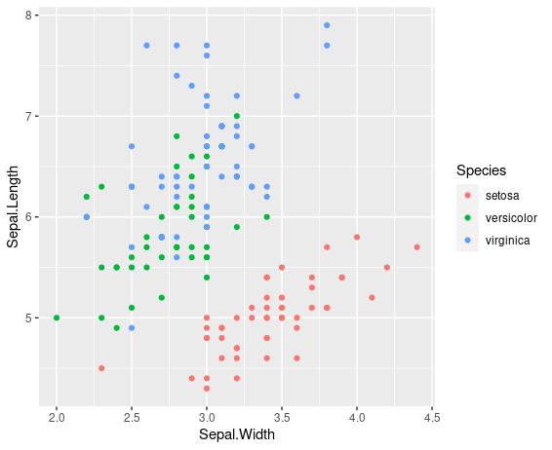
Multivariate scatterplot
ggplot(iris) + geom_point(aes(x = Sepal.Width, y = Sepal.Length, color = Species))
Notes:
Back to scatterplot
Does this show the whole data? What is the trend it is emphasizing?

Slide 14
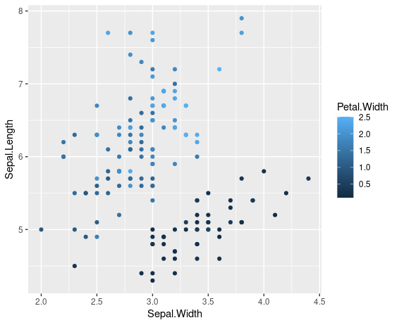
Multivariate scatterplot
ggplot(data = iris) + geom_point(mapping = aes(x = Sepal.Width, y = Sepal.Length, color = Pedal.Width))
Notes:
But do we really care about this relationship?

Slide 15
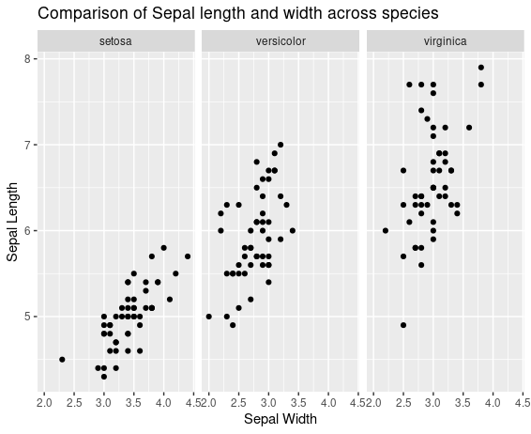
Multivariate scatterplot
ggplot(iris) + geom_point(aes(x = Sepal.Width, y = Sepal.Length)) + facet_wrap(~Species)

Slide 16
The general syntax
Data
Geometry, containing a mapping to the data
Additional settings
ggplot(iris) + geom_point(aes(x = Sepal.Width, y = Sepal.Length))
ggplot(<DATA>) + <GEOM_FUNCTION>(aes(<MAPPINGS>))

Slide 17
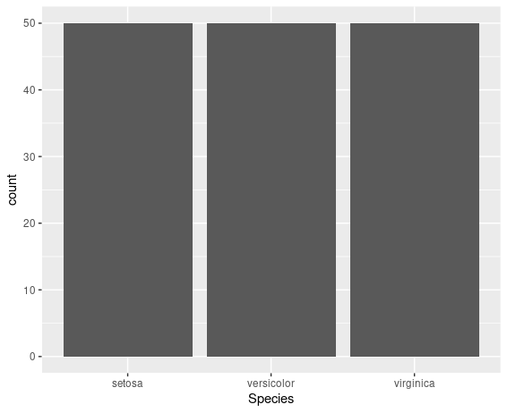
Bar plot
ggplot(iris) + geom_bar(aes(x = Species))
Notes:
Univariate data
Does this show the whole data? What is the trend it is emphasizing? Perhaps one can just use text to describe this?

Slide 18
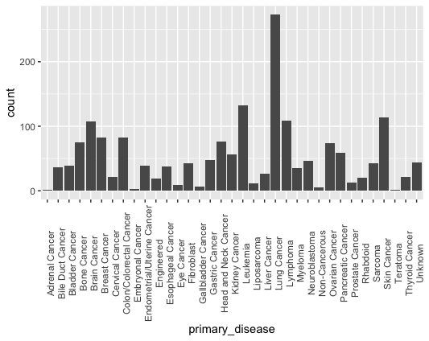
Bar plot
ggplot(metadata) + geom_bar(aes(x = primary_disease)) + theme(axis.text.x = element_text(angle = 90))
Notes:
Univariate data
Does this show the whole data? What is the trend it is emphasizing? Perhaps one can just use text to describe this?

Slide 19
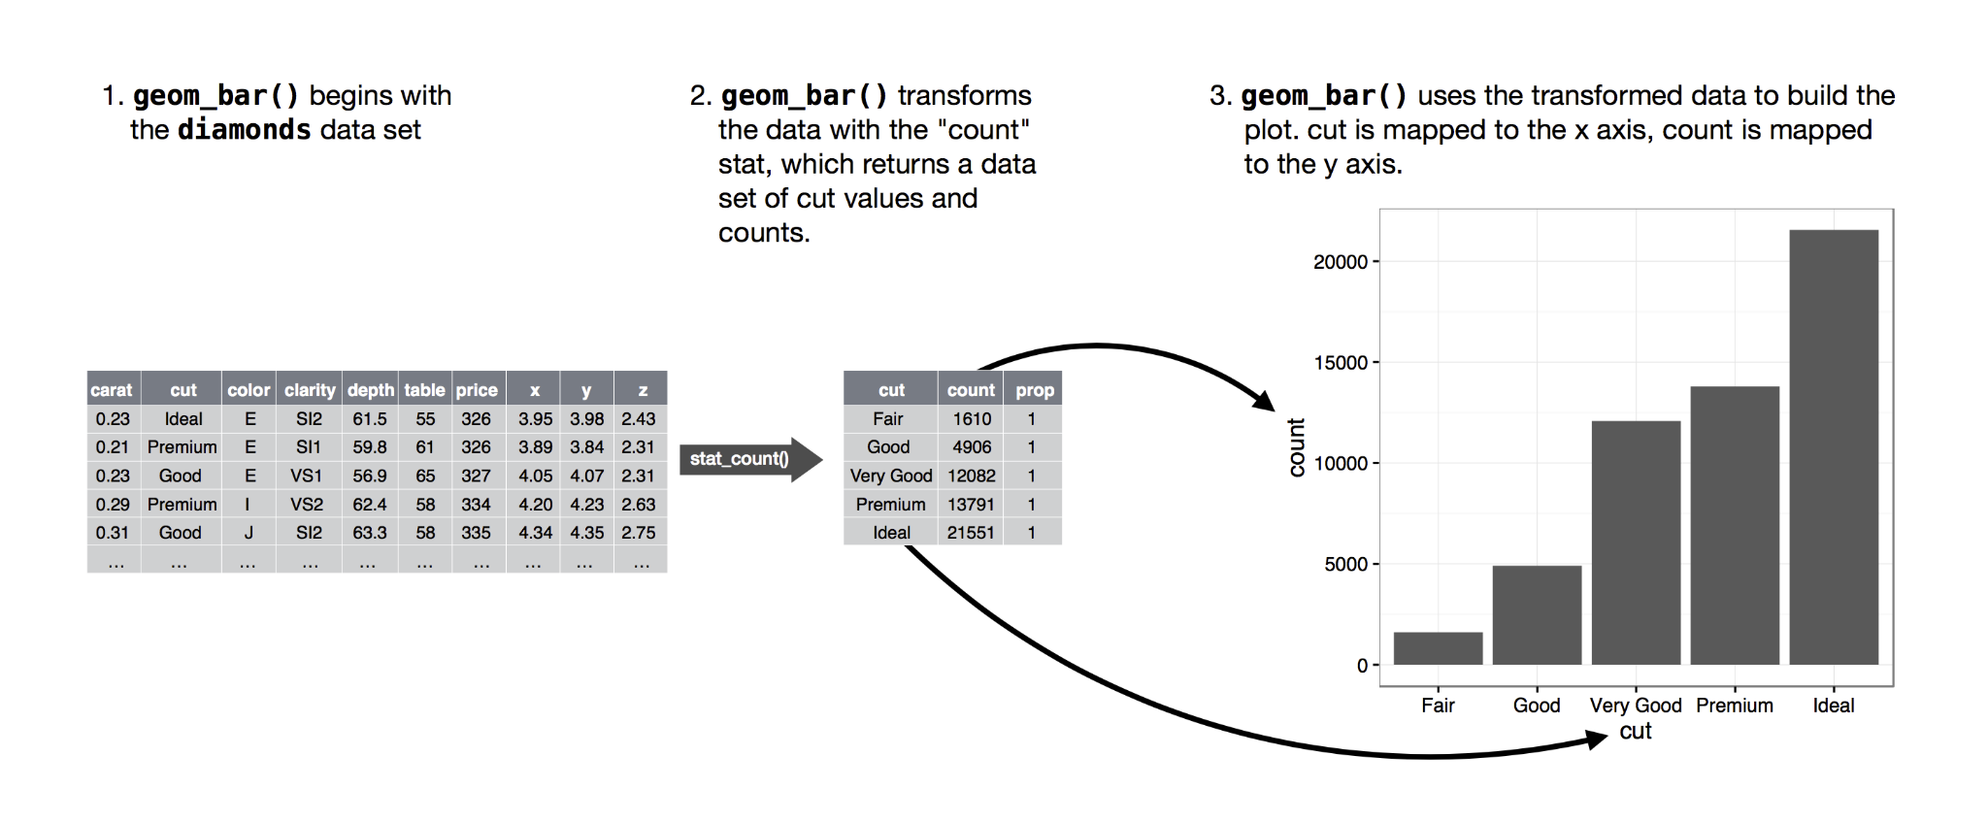
How is the barplot made?
Notes:
When the observation goes from diamonds to cut, what is happening to the dataframe? The summary(group_by(diamond, cut), count=n()) function.
https://r4ds.had.co.nz/data-visualisation.html

Slide 20
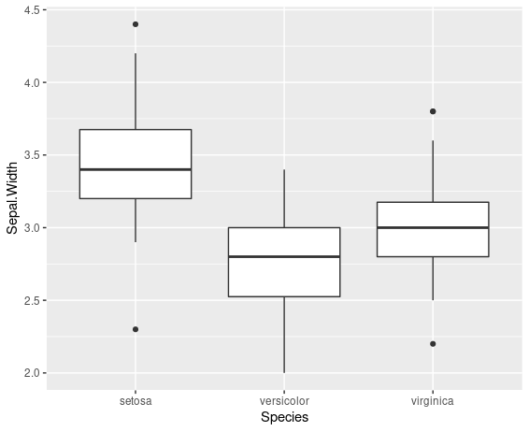
Boxplot
ggplot(iris) + geom_boxplot(aes(x = Species, y = Sepal.Width))
Notes:
Does this show the whole data? What is the trend it is emphasizing?

Slide 21
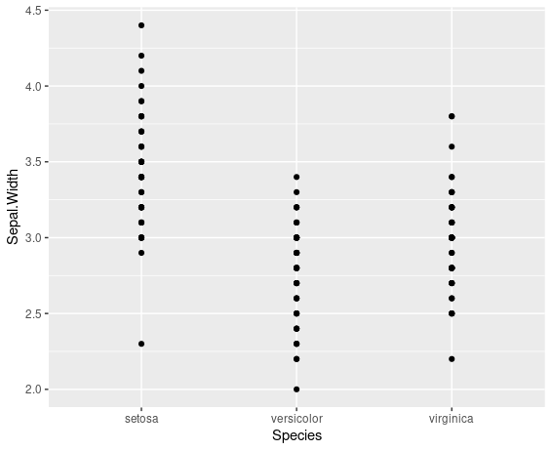
Scatterplot?
ggplot(iris) + geom_point(aes(x = Species, y = Sepal.Width))
Notes:
Compare the two plots. Does this show the whole data? What is the trend it is emphasizing? Less clear here.
Takeaway: ggplot will plot pretty much anything, but you have to decide whether it communicates your interpretation clearly.

Slide 22
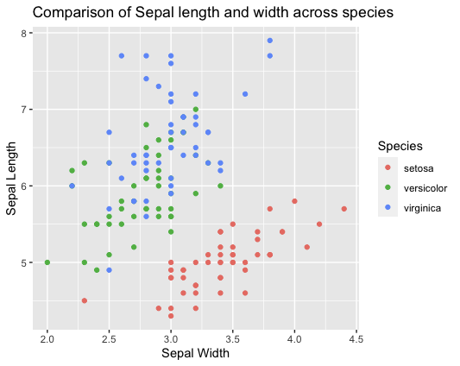
Additional settings - labels
ggplot(data = iris) + geom_point(mapping = aes(x = Sepal.Width, y = Sepal.Length, color = Species))+ labs(x = "Sepal Width", y = "Sepal Length", title = "Comparison of Sepal length and width across species")

Slide 23
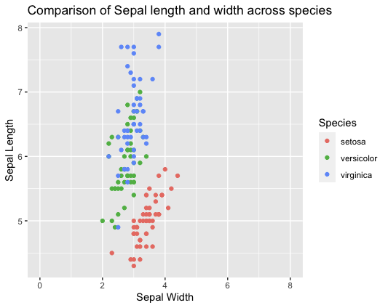
Additional settings - labels + scaling
ggplot(data = iris) + geom_point(mapping = aes(x = Sepal.Width, y = Sepal.Length, color = Species)) labs(x = "Sepal Width", y = "Sepal Length", title = "Comparison of Sepal length and width across species")+ scale_x_continuous(limits = c(0, 8))

Slide 24
Grammar of graphics (ggplot)
data
geom_point x, y, color, shape
geom_histogram x, y
geom_bar x, fill
geom_boxplot x, y, fill
facet
labs
scale_x_continuous
scale_y_continuous
scale_x_discrete
scale_y_discrete
Notes:
Geometry is a particular graphical display that usually depends on the data.
One can add more than one geometries.
The mapping argument maps the data to the graphical display - in particular, the x and y coordinates for scatterplot/geom_point.

Slide 25
How do we visualize some of this?
Gene A Expression Gene A Mutation Gene B Mutation Subtype ...
Sample 1
Sample 2
Sample 3
...

Slide 26
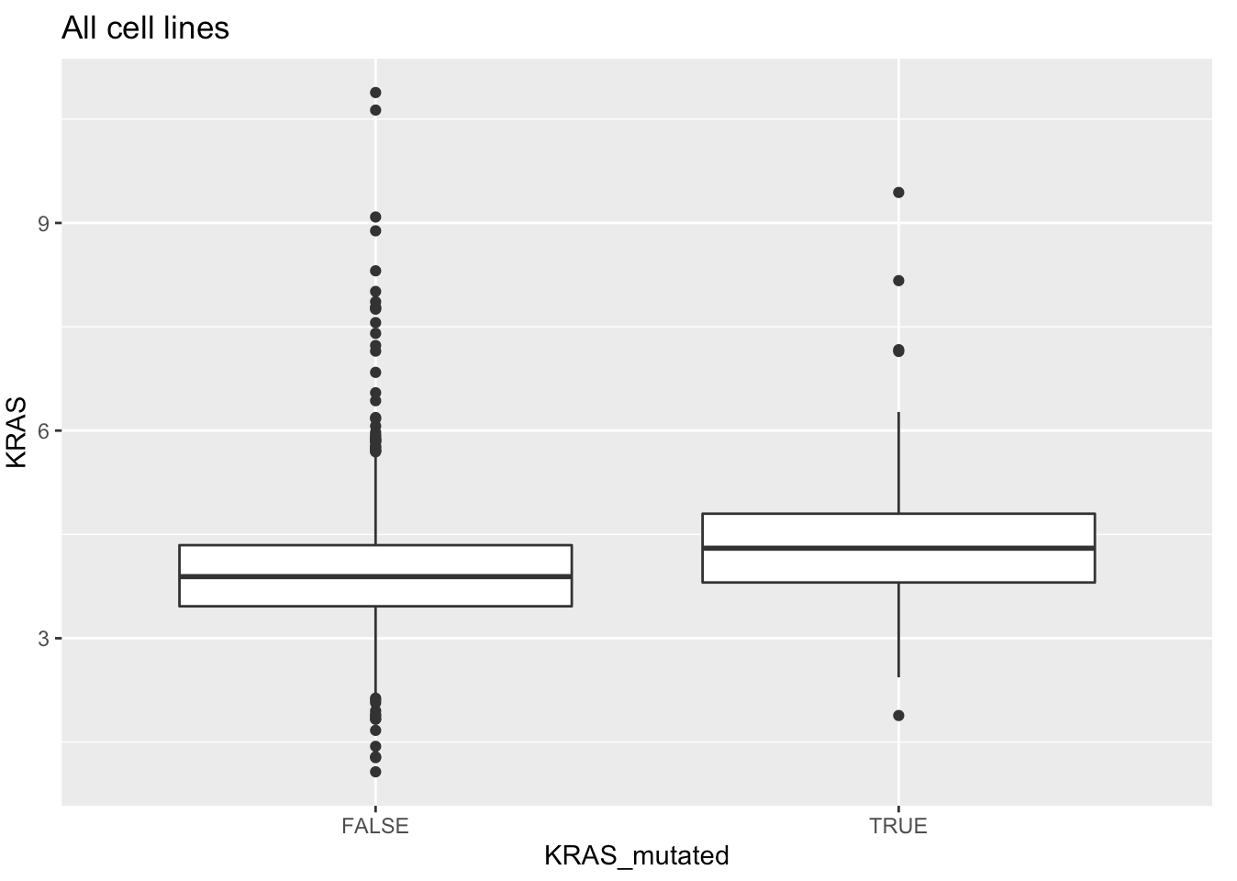
Comparing distributions
A distribution is the collection of observations for a specific variable, often summarized visually in a histogram.

Slide 27
Comparing distributions
How can we compare two distributions and say whether they are similar or not?

Slide 28
Comparing distributions
How can we compare two distributions and say whether they are similar or not?
Difference in means, difference in medians, etc… but these ideas don’t take into account the number of observations for each distribution. The more observations we have, the more confident we are about each distribution’s “true” shape (the “true” distribution).
Notes:
Allude to our class’s height example.

Slide 29
Comparing distributions
How can we compare two distributions and say whether they are similar or not?
Instead, ask: How likely will we see these two distributions like this if they belong to the same, “true” distribution?
If unlikely, then these distributions are probably different. If likely, then they are similar.
Notes:
Geometry is a particular graphical display that usually depends on the data.
One can add more than one geometries.
The mapping argument maps the data to the graphical display - in particular, the x and y coordinates for scatterplot/geom_point.

Slide 30
Comparing distributions
How likely will we see these two distributions like this if they belong to the same, “true” distribution? Check p-value < .05.
t.test(KRAS ~ KRAS_mutated, dataframe)
p-value = 5.261e-09
mean in group FALSE mean in group TRUE
3.955829 4.347323
Notes:
Geometry is a particular graphical display that usually depends on the data.
One can add more than one geometries.
The mapping argument maps the data to the graphical display - in particular, the x and y coordinates for scatterplot/geom_point.

Slide 31
Extra slides

Slide 32
Practice: wrangle the data, make a plot that answers the question
What is the frequency of cancer types in CCLE?
Is there an association between age and primary/metastatic cell lines at time of immortalization?
Is there an association between age and KRAS expression?
Notes:
Does this show the whole data? What is the trend it is emphasizing?

Slide 33
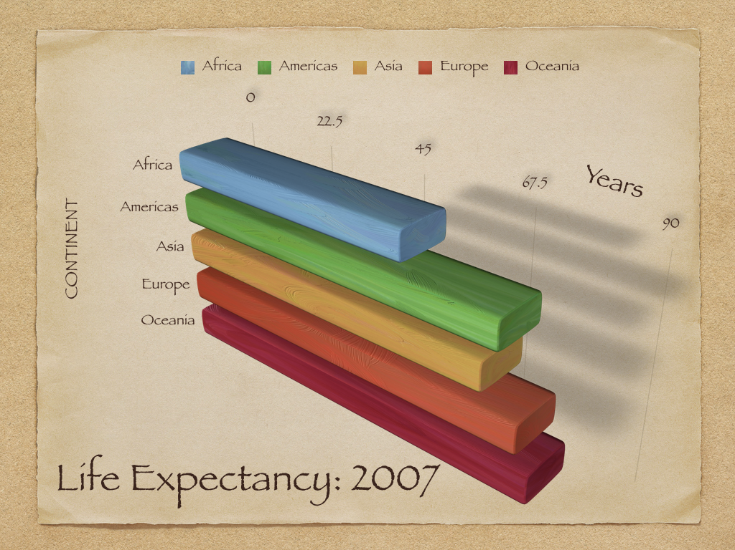

Notes:
Small
Edward Tufte’s criteria on data visualization

Slide 34
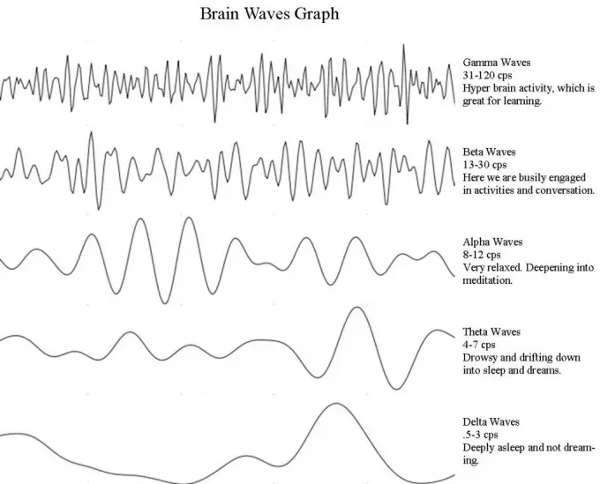
Notes:
Close to 1

Slide 35
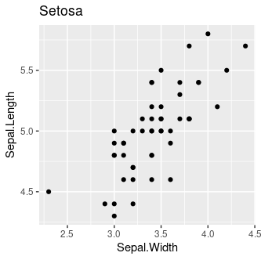
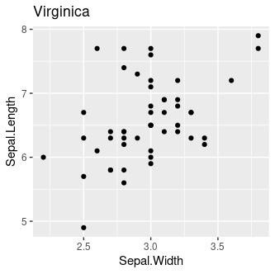

Notes:
Sometimes, it is not intentional!

Slide 36
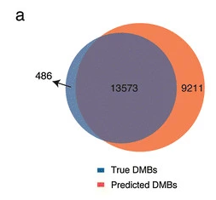
Notes:
> 1

Slide 37
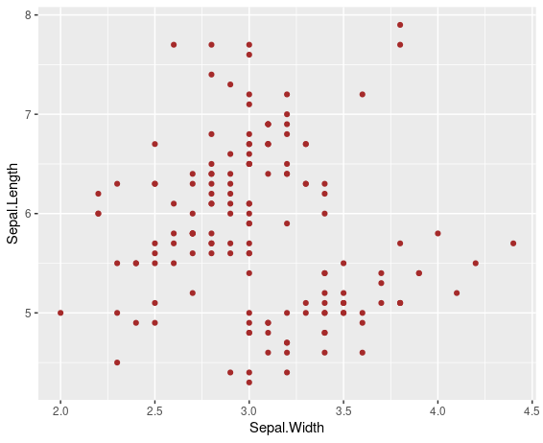
Mapping variable defined not by data
ggplot(data = iris) + geom_point(mapping = aes(x = Sepal.Width, y = Sepal.Length), color = “brown”)

